Slide 1


IBM Data Science Capstone Project Sebastian Motsch
7th January 24

Slide 2

Outline
Executive Summary
Introduction
Methodology
Results
Conclusion
Open Questions
Outlook and Proposals
Appendix

Slide 3
Executive Summary
Summary of methodologies
Data Collection through APIs
Automated Data Collection with Web Scraping
Data cleaning and Wrangling
Exploratory Data Analysis (EDA) using SQL
EDA with Advanced Data Visualization techniques
Interactive Visual Analytics using Folium for Geospatial Data
Machine Learning Predictive Modeling and Evaluation for Each Classification Algorithm
Summary of all results
Exploratory Data Analysis Results Including Interactive Visualizations
Screenshots of Interactive Analytics
Predictive Analytics Results and Conclusion of the Best Prediction Model

Slide 4
Introduction
Project background and context The capstone's main objective is to use machine learning to predict the successful landing of the Falcon 9's first stage and to understand driving success parameters. With Space X charging $62 million for launches, which is more than 60% less than competitors’ $165 million, the key to this cost advantage is reusing the first stage. A reliable prediction model can clarify launch costs and offer a competitive benchmark for other companies. Based on identified driving success parameters, an outlook is given.
Problems you want to find answers Which factors influence the successful landing of the first stage of a rocket? How do interrelated parameters affect the likelihood of a successful landing? What are the optimal operational conditions required for the first stage to land successfully?

Slide 5

Section 1

Slide 6
Methodology
Executive Summary
Data collection methodology:
Data was collected using SpaceX Rest API and by web scraping from Wikipedia
Perform data wrangling
One-hot encoding was applied to categorical features, and irrelevant data was either excluded or replaced.
Perform exploratory data analysis (EDA) using visualization and SQL to identify patterns, which were illustrated through graphs.
Perform interactive visual analytics using Folium and Plotly Dash
Perform predictive analysis using classification models
Predictive analysis was executed using several classification models, focusing on how to build, tune, and evaluate each model effectively.

Slide 7
Data Collection
Data was sourced through multiple methods:
Utilized a GET request to the SpaceX API.
Decoded the API response using the .json() function and converted it to a pandas dataframe with .json_normalize().
Web scraping from Wikipedia was done for Falcon 9 launch records using BeautifulSoup.
The objective of scraping was to:
Extract Falcon 9 launch records from an HTML table.
Parse the table data and convey it to a pandas dataframe for further analysis.
Cleaned the data:
Checked for missing values.
Filled in missing values as needed.
Filtered the dataframes based on specific requirements.
Exported the cleaned and filtered data to a CSV file.

Slide 8
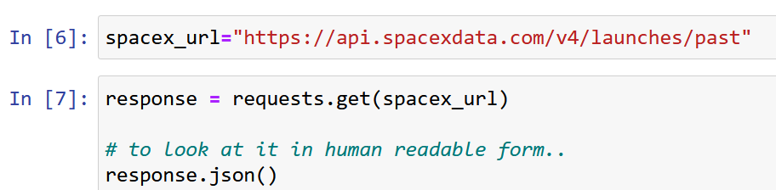
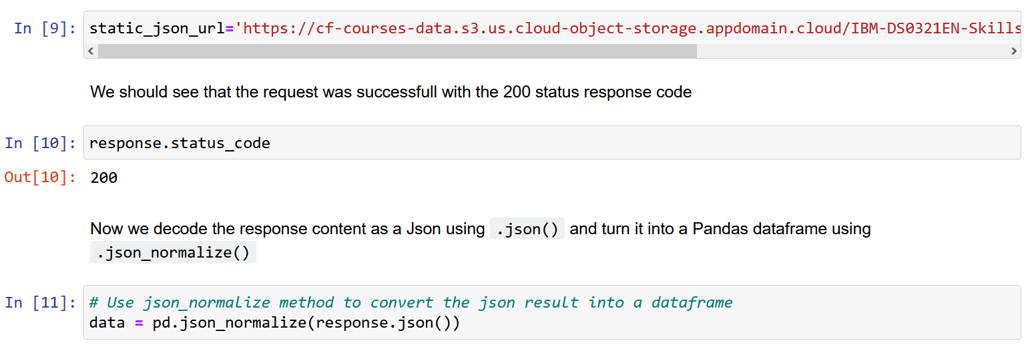
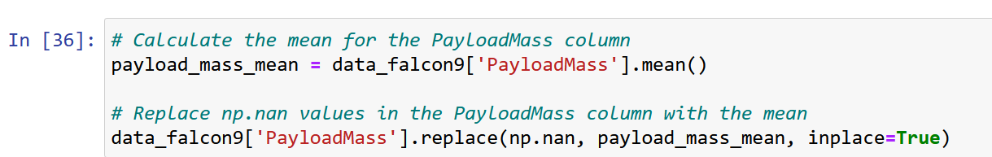
Data Collection – SpaceX API
Send a GET request to retrieve rocket launch data using the API.
Use the json_normalize method to convert the JSON result into a DataFrame.
Perform data cleaning and fill in the missing values.
Data was gathered and collected through a GET request from the SpaceX API, and the retrieved data was then cleaned, completed, and formatted using basic and fundamental data wrangling techniques.
The link to the notebook is https://github.com/sebnotch/presi-and-code-data-science/blob/main/jupyter-labs-spacex-data-collection-api.ipynb

Slide 9
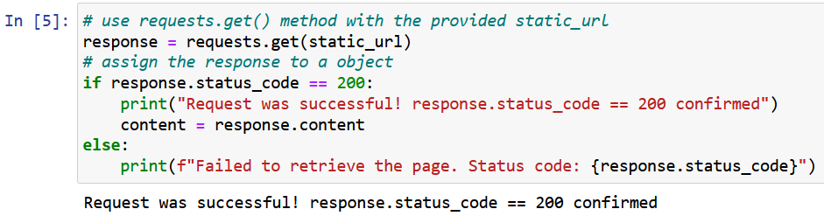
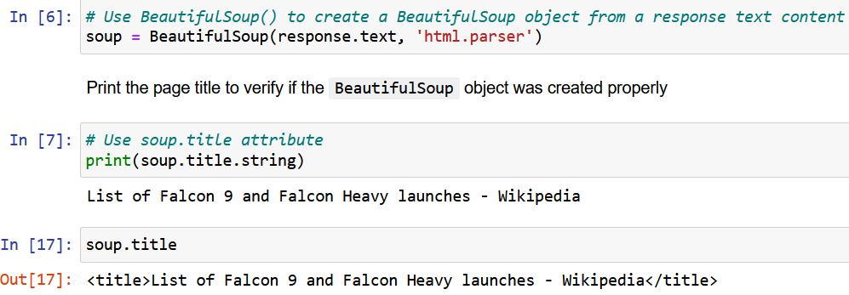
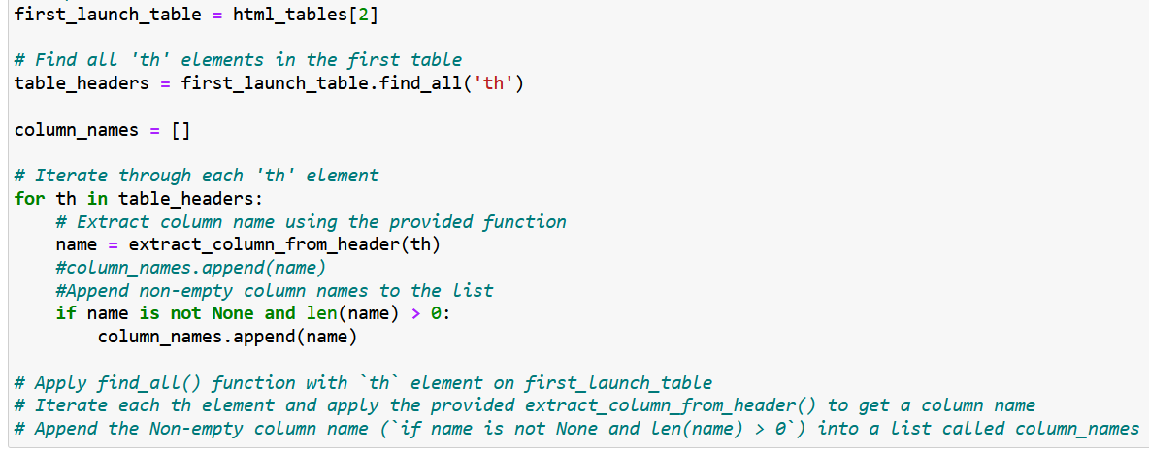
Data Collection – Web Scraping
Perform an HTTP GET request to retrieve the Falcon 9 Launch HTML page.
Create a BeautifulSoup object from the HTML response
Extract column names from the HTML table header.
Parse the launch HTML tables to create a DataFrame.
Export the DataFrame to a CSV file.
Web scraping with BeautifulSoup was utilized to extract Falcon 9 launch records, and the HTML table was subsequently parsed and transformed into a pandas DataFrame.
The link to the notebook is https://github.com/sebnotch/presi-and-code-data-science/blob/main/jupyter-labs-webscraping.ipynb

Slide 10

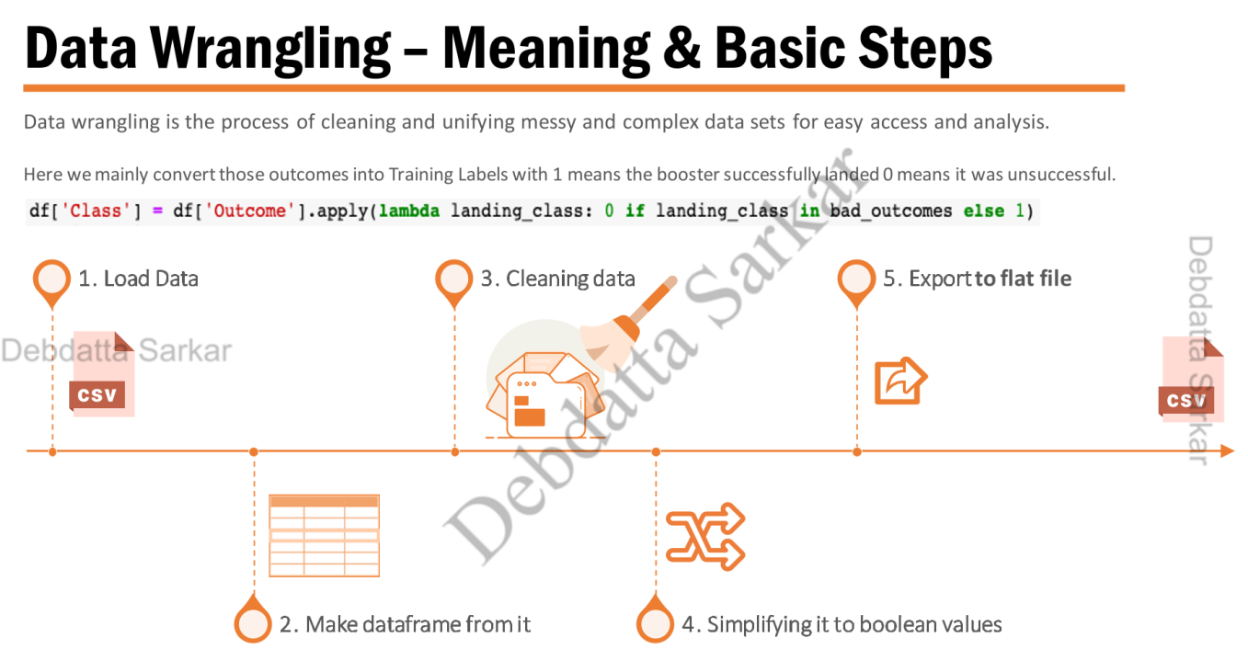
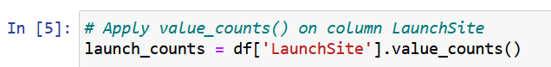
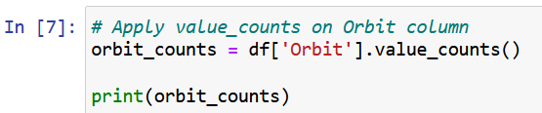
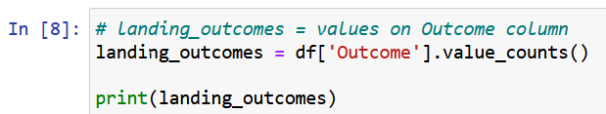
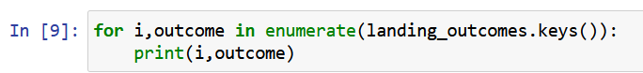
Data Wrangling
Basic steps of data wrangling applied
Import Libraries and Define Auxiliary Functions, load data
Conduct Data Analysis
Load the SpaceX dataset
Create a concise, cleaned DataFrame, simplifying to Boolean values where sensible, and understand numerical and categorical columns
Calculate the number of launches at each site
Determine the number and occurrence of each orbit
Calculate the number and occurrence of mission outcomes for the orbits
Generate a landing outcome label from the Outcome column
Export the dataset to a flat file as a CSV file
The link to the notebook is https://github.com/sebnotch/presi-and-code-data-science/blob/main/labs-jupyter-spacex-Data%20wrangling.ipynb
a) b)
c)
d)

Slide 11
Exploratory Data Analysis (EDA) with Data Visualization
Data was explored by visualizing
(Task 0) Flight number vs. payload mass - Scatter point chart (scatter plot)
(Task 1) Visualizing the relationship between flight number and launch site - Scatter point chart
(Task 2) Payload and launch site - Scatter point chart
(Task 3) Success rate of each orbit type - Bar chart
(Task 4) Flight number and orbit type - Scatter point chart
(Task 5) Payload and orbit type - Scatter point chart
(Task 6) Yearly trend of launch success - Line plot chart (line graph)
The link to the notebook is https://github.com/sebnotch/presi-and-code-data-science/blob/main/jupyter-labs-eda-dataviz.ipynb
Scatter plots are valuable for visualizing correlations between parameters. This assists in identifying relevant features for predictive modeling. In this case, scatter plots help to estimate the likelihood of success, taking into account both outcomes and landings.
Bar graphs, when applied to preselected attributes, demonstrate the interrelationships among them and indicate which orbits are associated with a higher success rate.
Line graphs are beneficial for tracing trends, such as the annual trend in success rates.

Slide 12
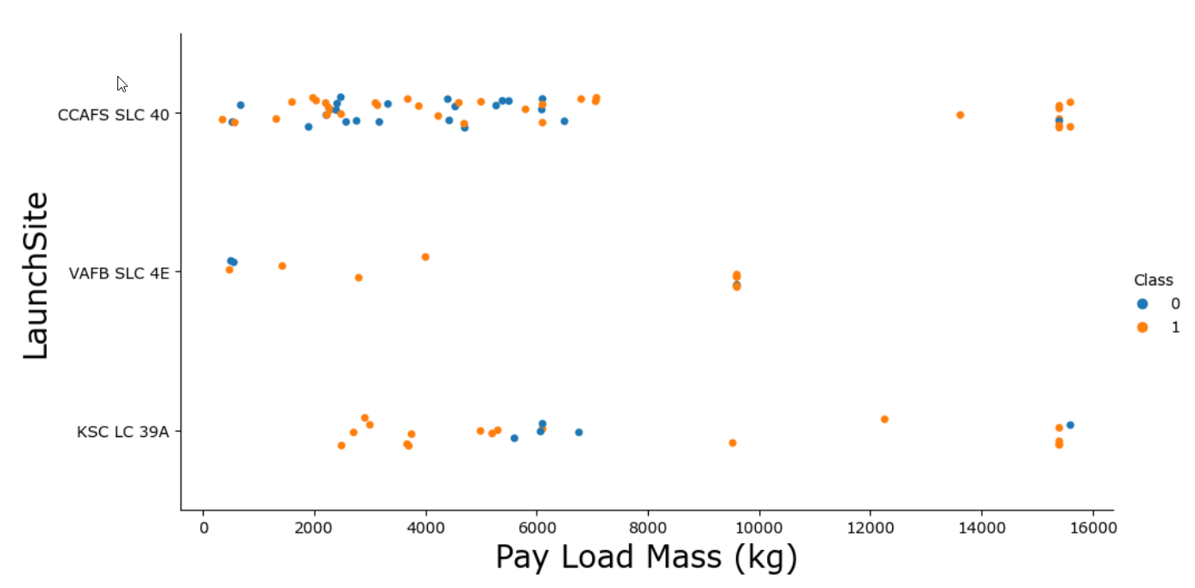
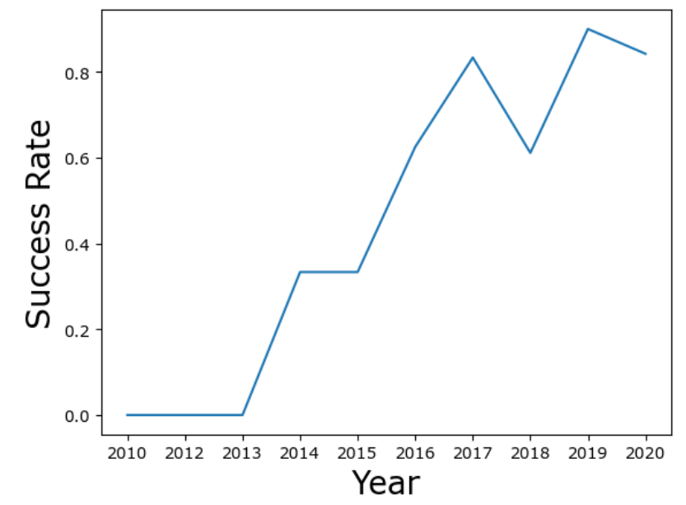
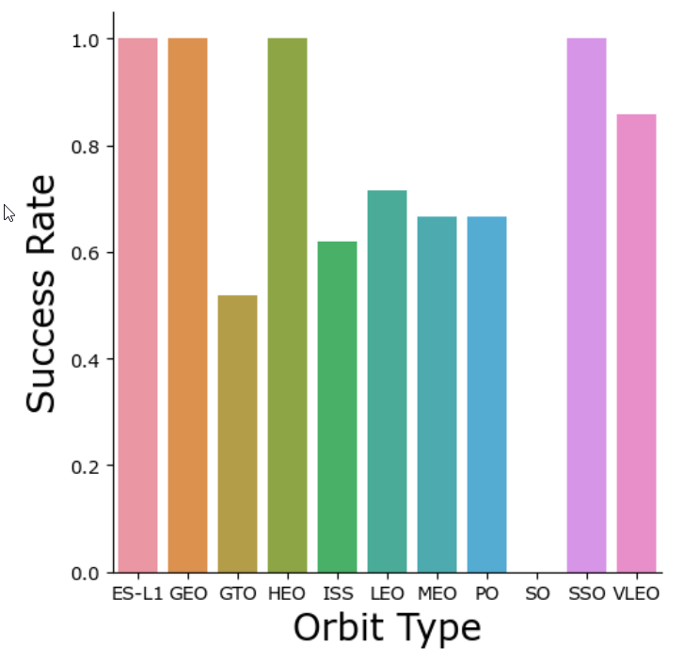
EDA with Data Visualization – continued, depicted
Example scatter plot
Example line graphs
The link to the notebook is https://github.com/sebnotch/presi-and-code-data-science/blob/main/jupyter-labs-eda-dataviz.ipynb
Example bar graph

Slide 13
Exploratory Data Analysis (EDA) with SQL queries
Examples for SQL queries
%sql SELECT * FROM SPACEXTABLE LIMIT 5;
%sql SELECT DISTINCT "LAUNCH_SITE" FROM SPACEXTBL;
%sql SELECT * FROM SPACEXTABLE WHERE "LAUNCH_SITE" LIKE 'KSC%' LIMIT 5;
%sql SELECT SUM("PAYLOAD_MASS__KG_") FROM SPACEXTABLE WHERE "Customer" LIKE 'NASA (CRS)’;
%sql SELECT AVG("PAYLOAD_MASS__KG_") FROM SPACEXTABLE WHERE "Booster_Version" LIKE 'F9 v1.1’;
%sql SELECT MIN("DATE") FROM SPACEXTBL WHERE "LANDING__OUTCOME" LIKE "Success (drone ship)" ;
%sql SELECT "Booster_Version" FROM SPACEXTBL \ WHERE "LANDING__OUTCOME_" LIKE "Success (drone ship)" \ AND "PAYLOAD_MASS__KG_" BETWEEN 4000 AND 6000 ;
%sql SELECT MISSION_OUTCOME, COUNT(*) as total_number \ FROM SPACEXTBL \ GROUP BY MISSION_OUTCOME;
%sql SELECT BOOSTER_VERSION \ FROM SPACEXTBL \ WHERE PAYLOAD_MASS__KG_ = (SELECT MAX(PAYLOAD_MASS__KG_) FROM SPACEXTBL);
%sql SELECT substr(Date,4,2) as month, DATE,BOOSTER_VERSION, LAUNCH_SITE, [Landing_Outcome] \ FROM SPACEXTBL \ where [Landing_Outcome] = 'Success (ground pad)' and substr(Date,7,4)='2017’;
%sql SELECT [Landing_Outcome], count(*) as count_outcomes \ FROM SPACEXTBL \ WHERE DATE between '04-06-2010' and '20-03-2017’ \ group by [Landing_Outcome] order by count_outcomes DESC;
The link to the notebook is https://github.com/sebnotch/presi-and-code-data-science/blob/main/jupyter-labs-eda-sql-edx_sqllite(1)_as_done_on_skills_network.ipynb

Slide 14
EDA with SQL continued - queries explained
With SQL, EDA was conducted to get insights from the data. Queries were formulated to determine:
The unique launch site names used in the space mission.
Display 5 records where launch sites begin with the string 'KSC'
The total payload mass carried by boosters launched for NASA (CRS).
The average payload mass carried by the booster version F9 v1.1.
List the date where the first successful landing outcome in drone ship was achieved.
List the names of the boosters which have success in ground pad and have payload mass greater than 4000 but less than 6000
List the total number of successful and failure mission outcomes
List the names of the booster versions which have carried the maximum payload mass.
List the records which will display the month names, successful landing outcomes in ground pad, booster versions, launch site for the months in year 2017
Rank the count of landing outcomes (such as Failure (drone ship) or Success (ground pad)) between the date 2010-06-04 and 2017-03-20, in descending order
The link to the notebook is https://github.com/sebnotch/presi-and-code-data-science/blob/main/jupyter-labs-eda-sql-edx_sqllite(1)_as_done_on_skills_network.ipynb

Slide 15
Build an Interactive Map with Folium
Folium provides Python-based tools for creating interactive maps:
Launch sites are pinpointed on the map with symbols that indicate the success or failure of each launch.
Launch outcomes are categorized as '0' for failure and '1' for success.
Color-coded marker clusters are used to identify launch sites with higher success rates.
The calculated distances address the following:
The proximity of launch sites to railways, highways, and coastlines.
The maintenance of a certain distance between launch sites and cities.
The link to the notebook is https://github.com/sebnotch/presi-and-code-data-science/blob/main/lab_jupyter_launch_site_location.jupyterlite_SOLVED.ipynb

Slide 16
Build an Interactive Map with Folium - continued
Map Objects | Code | Purpose of adding those objects
Circle marker | Folium.Circle | add a highlighted circle
Map marker | Folium.Marker | Mapping object for marking on the map
Marker cluster object | Marker_cluster | Grouping points of interest which are close to each other
Polyline | Folium.PolyLine | Drawing a line between points.
Icon Marker | Folium.Icon | Create an icon on the map.
The link to the notebook is https://github.com/sebnotch/presi-and-code-data-science/blob/main/lab_jupyter_launch_site_location.jupyterlite_SOLVED.ipynb

Slide 17
Build a Dashboard with Plotly Dash
To visualize and analyze launch data, a dashboard was constructed using Plotly Dash. The development process covers the following steps:
Developed an interactive dashboard using Plotly Dash for dynamic data exploration.
Integrated a Launch Site Dropdown Component to enable selection of individual launch sites or the option to view the data of all sites.
Generated pie charts to show the total number of launches by each site, enabling understanding of the success and failure rates, such as payload mass.
Implemented a Payload Range Slider, allowing users to filter launch data based on specified ranges of payload.
Created a scatter plot to show the relationship between launch outcomes and payload for various booster versions. This ebables to understand how booster types affect associated to success rates.
The link to the notebook is https://github.com/sebnotch/presi-and-code-data-science/blob/main/spacex_dash_app.py

Slide 18
Predictive Analysis (Classification)
Loaded the data with numpy and pandas.
Transformed data into NumPy arrays.
Divided the dataset into training and testing sets.
Developed multiple machine learning models.
Tuned model hyperparameters using GridSearchCV and trained the models.
Measured model performance using accuracy.
Applied feature engineering to improve model performance.
Determine optimum hyperparameters for each algorithm
Fine-tuned algorithms for better results.
Plot the confusion matrix
Identified the classification model with the highest accuracy.
Data Preparation and Model Development
Model Evaluation and Model Improvement
Final Model Selection
The link to the notebook is https://github.com/sebnotch/presi-and-code-data-science/blob/main/SpaceX_Machine_Learning_Prediction_Part_5.jupyterlite.ipynb

Slide 19
Results
Exploratory data analysis results
Patterns within the data were identified
There are clearly success driving parameters
Interactive analytics demo in screenshots
Visualization is an important part of the approach
Predictive analysis results
Predictions could clearly be established at a high confidence rate

Slide 20

Section 2

Slide 21
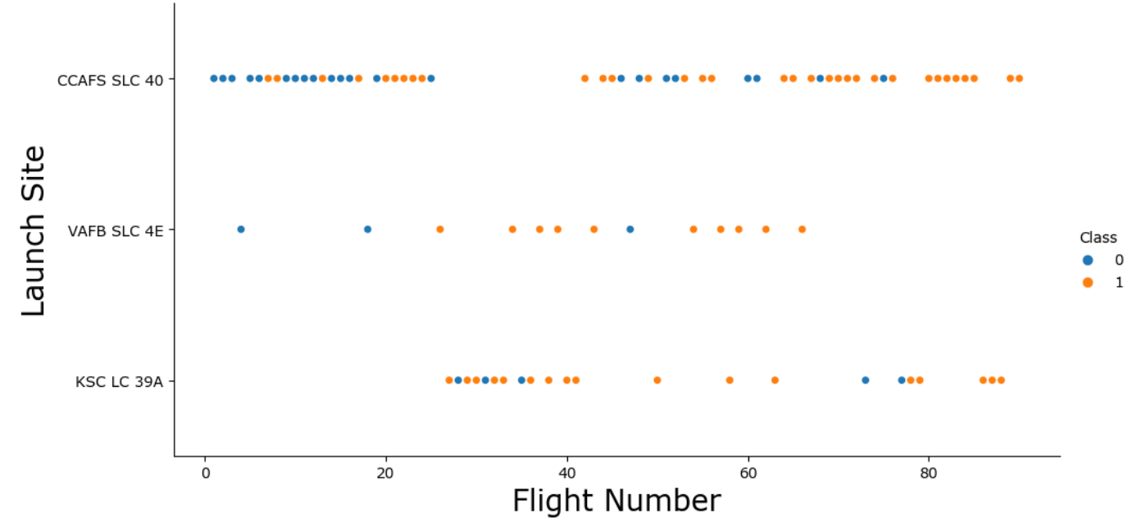
Flight Number vs. Launch Site
Diagram: scatter plot of Flight Number vs. Launch Site
Conclusion: ➔ Initial flights show a higher incidence of failure, whereas later flights generally achieve more success, independent of the launch site

Slide 22
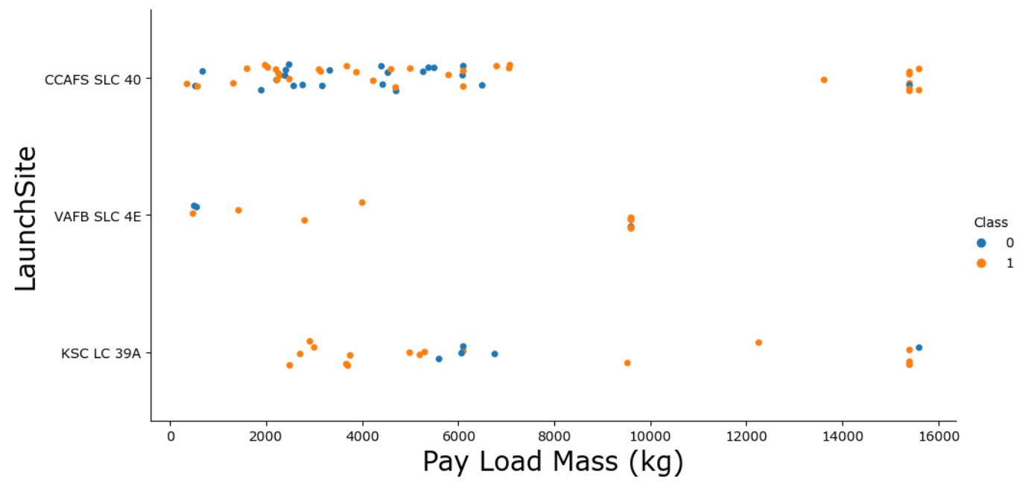
Payload vs. Launch Site
Diagram: scatter plot of Pay Load vs. Launch Site
Conclusion: ➔ Conclusion: Larger payloads usually lead to more successful launches, regardless of where they launch from. However, the CCAFS SLC 40 site shows the highest success rates with heavy payloads.

Slide 23
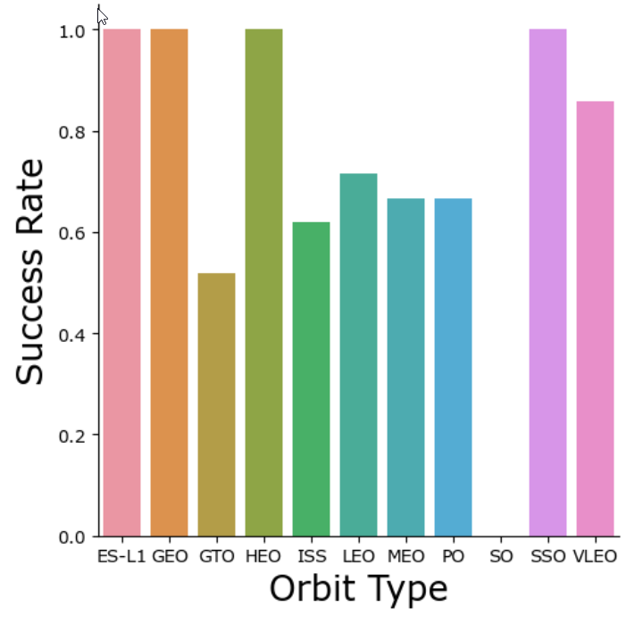
Success Rate vs. Orbit Type
Diagram: bar chart of Success Rate vs. Orbit Type
Conclusion: ➔ ES-L1, GEO, HEO, SSO have biggest success rate, followed by VLEO

Slide 24
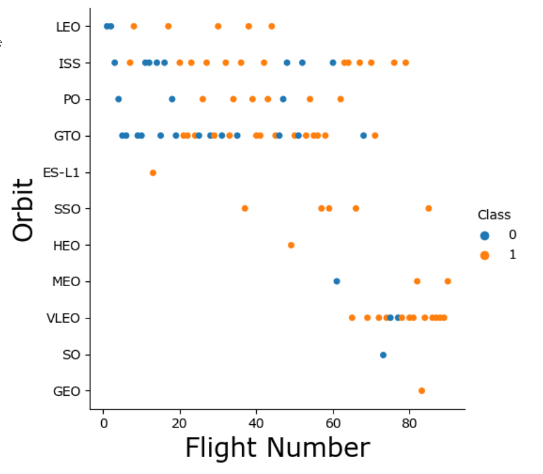
Flight Number vs. Orbit Type
Conclusion
There is a continuous increase in successful launches for Low Earth Orbit (LEO) without exception.
Across all launch sites, there is a trend of improvement in the success rate of launches over time.
For specific orbits, namely ES-L1, SSO (Sun-Synchronous Orbit), HEO (Highly Elliptical Orbit), and GEO (Geostationary Orbit), there is a record of 100% success of all flights. However, these orbits account for a smaller proportion of the total number of launches.
Diagram: scatter plot of Orbit Type vs Flight Number

Slide 25
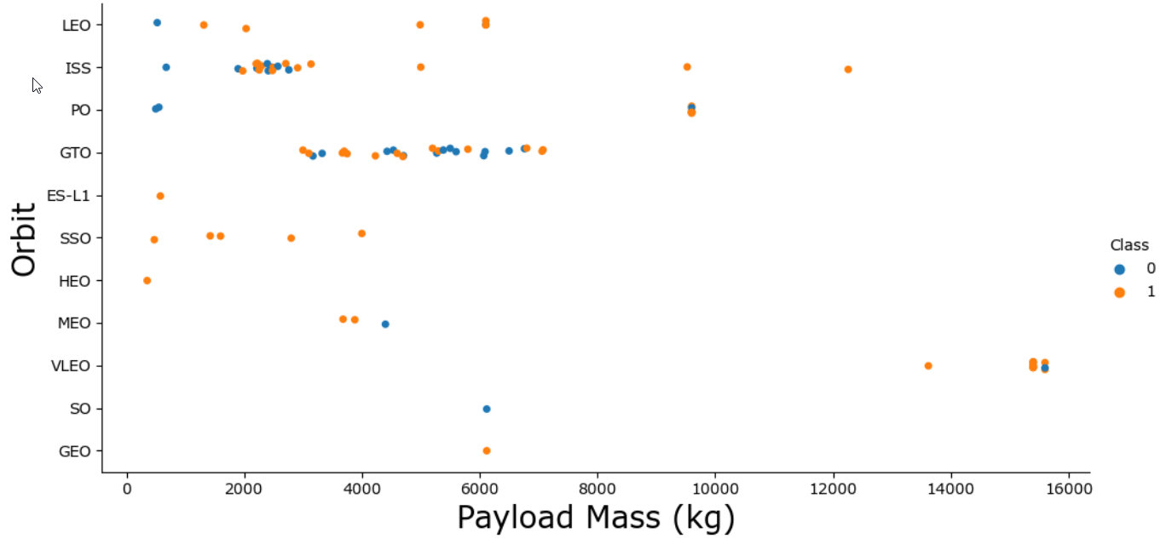
Payload vs. Orbit Type
Conclusion
Higher payloads are often linked to higher success rates in launches. At highest payloads, there is only one exception.
Orbits like ES-L1, SSO, HEO, and GEO, with fewer flights, appear to be exceptions to this trend.
This suggests that smaller payloads might be used for some kind of test flights, while larger payloads are intended for missions expected to succeed.
Diagram: scatter plot of Payload vs Orbit

Slide 26
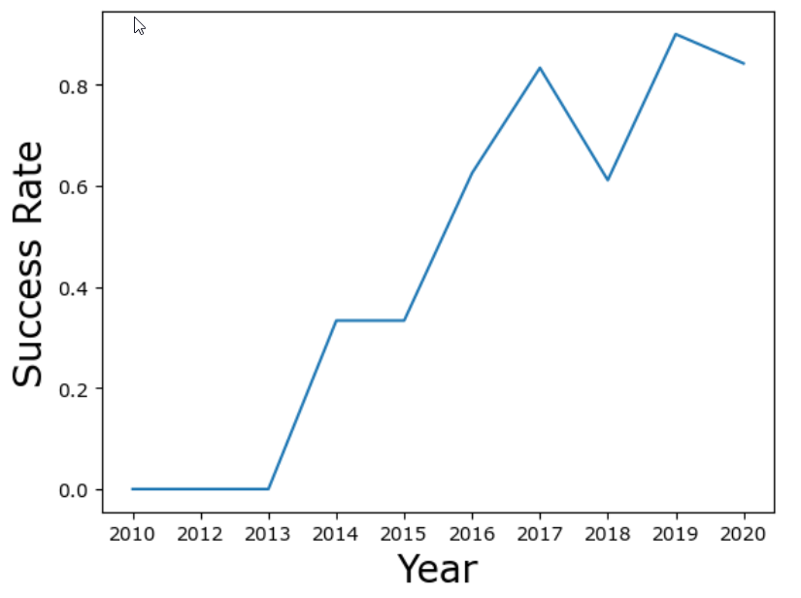
Launch Success Yearly Trend
Conclusion
Since successful launches are to be observed (2013), the success rate increases
The increase of the success rate is steeper in the beginning, roughly up to 2017 than in later years
However, the success rate remains quite high at about 80% since 2017
One exception to this, the year 2018 at 60% success rate appears to be an outlier, as 2017, 2019 and 2020 success rate are bigger than 80%
Diagramm: scatter plot of launch success yearly trend

Slide 27
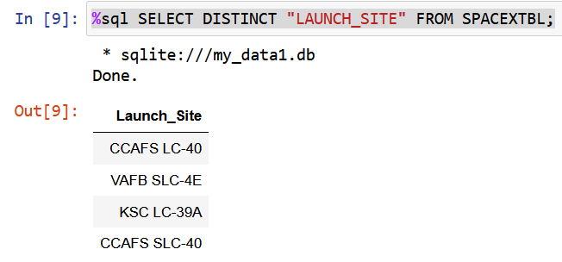
All Launch Site Names
The key point of finding the names of the unique launch sites is the use of ‘DISTINCT’ in the SQL query.
CCAFS LC-40: Cape Canaveral Air Force Station Launch Complex 40, located in Florida, USA.
VAFB SLC-4E: Vandenberg Air Force Base Space Launch Complex 4E, located in California, USA.
KSC LC-39A: Kennedy Space Center Launch Complex 39A, located in Florida, USA.
CCAFS SLC-40: Cape Canaveral Air Force Station Space Launch Complex 40, located in Florida, USA.

Slide 28
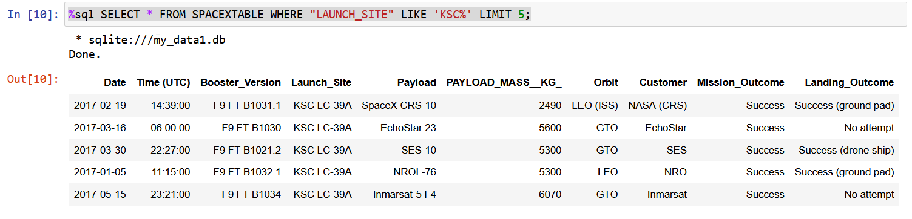
Launch Site Names Begin with 'KSC'
Points of finding 5 records where launch sites’ names start with `KSC` are the use of
‘…LIKE `KSC%`… ’ in order to select launch sites containing ‘KSC’ and
‘LIMIT 5;’ in order to limit the findings to a number of 5
in the SQL query. It was doublechecked, that the output provided data as intended.

Slide 29
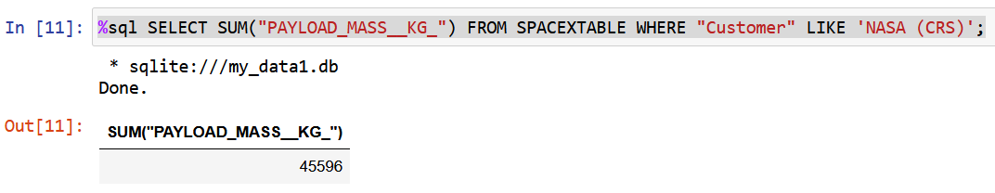
Total Payload Mass
The key point of calculating the total payload carried by boosters from NASA is the use of ‘SELECT SUM…’ in the SQL query.

Slide 30
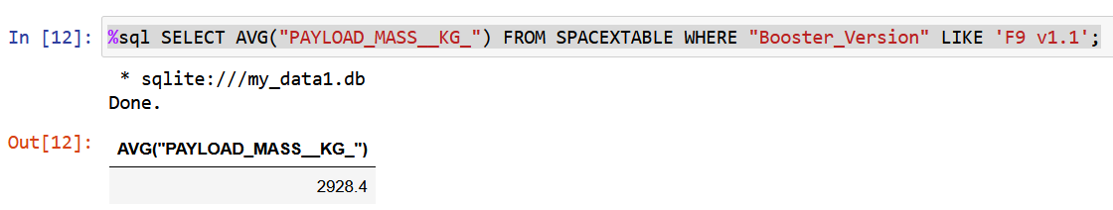
Average Payload Mass by F9 v1.1
The key point of calculating the average payload mass carried by booster version F9 v1.1 is the use of ‘AVG…’ in the SQL query.

Slide 31
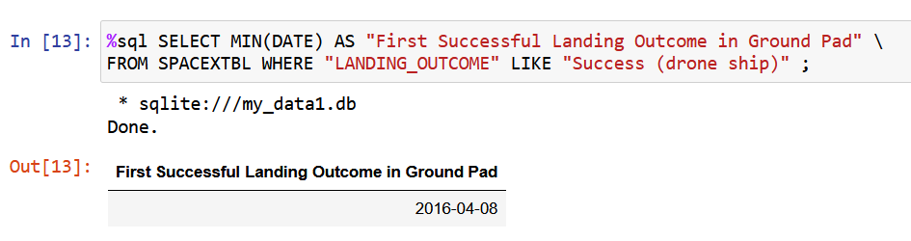
First Successful Ground Landing Date
The key point of finding the dates of the first successful landing outcome on drone ship is the use of
‘MIN’ applied to “DATE” were the
‘LANDING__OUTCOME’ is ‘Success (drone ship)’
in the SQL query.

Slide 32
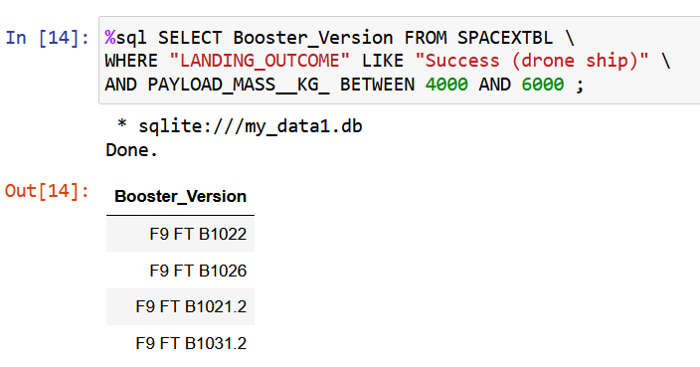
Successful Drone Ship Landing with Payload between 4000 and 6000
The key point of listing the names of boosters which have successfully landed on drone ship and had payload mass greater than 4000 but less than 6000 is to apply ‘WHERE’ covering:
‘LANDNG__OUTCOME_ ‘Success (drone ship)’ and
‘PAYLOAD_MASS__KG_ BETWEEN 4000 AND 6000’
in the SQL query.

Slide 33
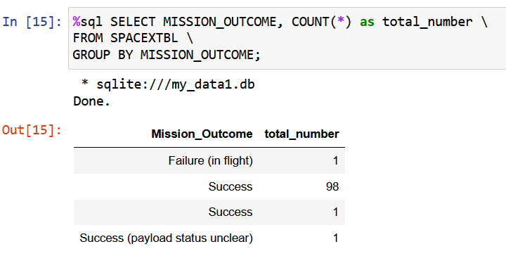
Total Number of Successful and Failure Mission Outcomes
The key point of calculating the total number of successful and failure mission outcomes is to apply ‘COUNT’ and ‘SELECT MISSION_OUTCOME’ in the SQL query.
The conclusion is, that the number of
Failure missions is 1
Successful missions is 100

Slide 34
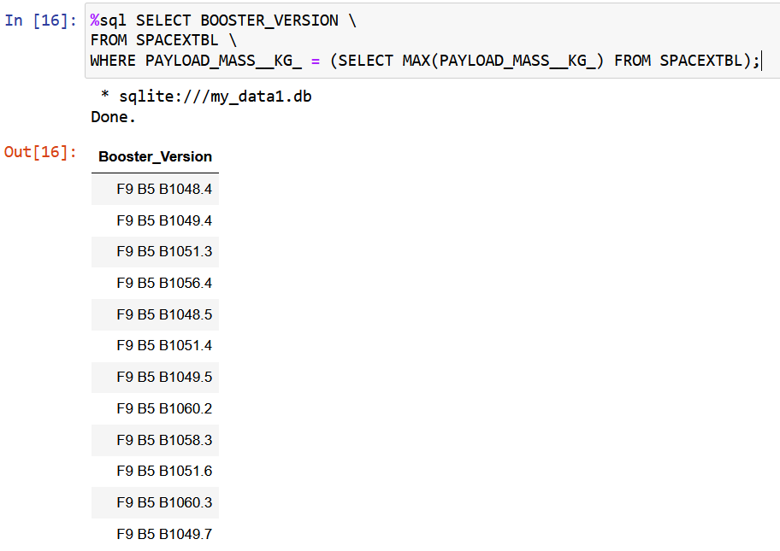
Boosters Carried Maximum Payload
The key point of listing the names of the booster which have carried the maximum payload mass is to apply SELECT to MAX(PAYLOAD_MASS__KG_ in the SQL query plus subquery.

Slide 35
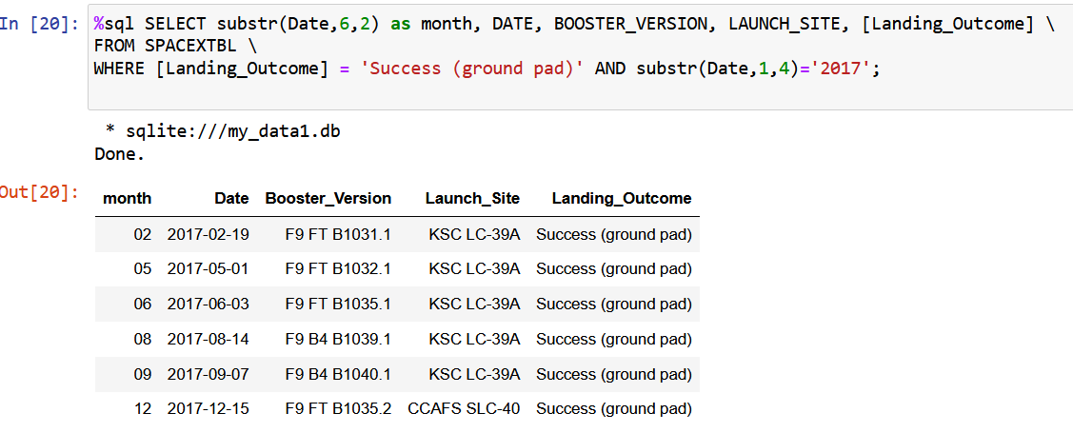
2017 Success (ground pad) Landing
The key point of listing the records which will display the month names, succesful landing_outcomes in ground pad, booster versions, launch_site for the months in year 2017 is to apply SELECT in a way that filters the records to only include entries from the year 2017 like "substr(Date,1,4)='2017'".

Slide 36
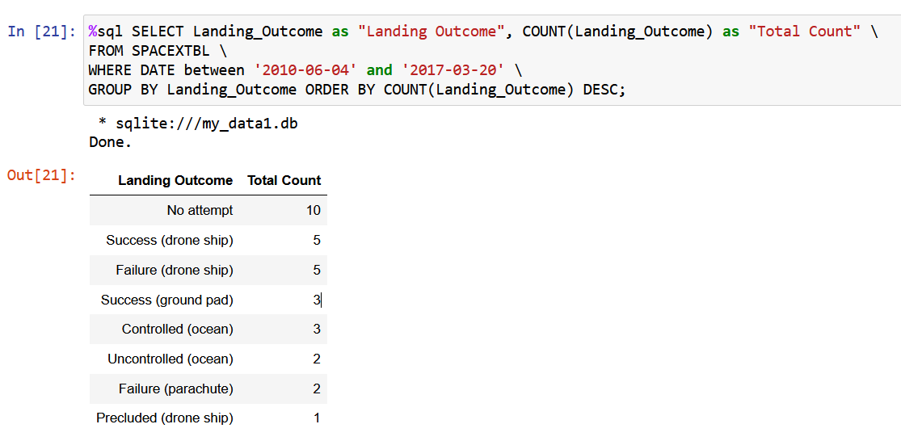
Rank Landing Outcomes Between 2010-06-04 and 2017-03-20
The key point of ranking the count of landing outcomes (such as Failure (drone ship) or Success (ground pad)) between the date 2010-06-04 and 2017-03-20, in descending order is to identify the most frequent landing outcomes during that period using GROUP BY Landing_Outcome ORDER BY COUNT(Landing_Outcome) DESC.

Slide 37

Section 3

Slide 38
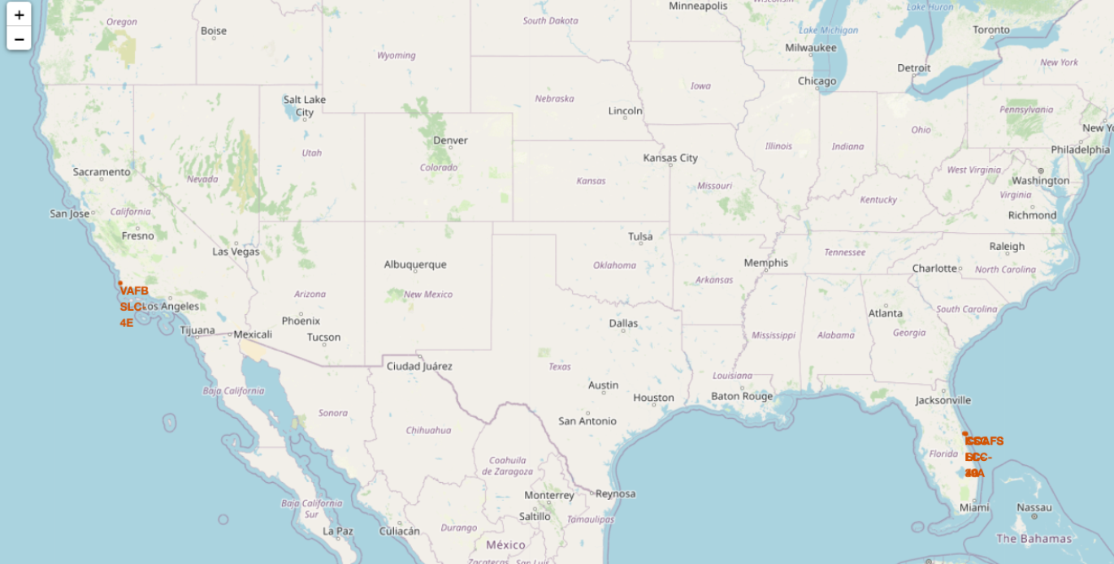
Location of SpaceX launch sites
All SpaceX launch sites are located
Within the USA
In the southern regions of the USA
Close to the sea
Near transportation infrastructure
Away from large cities
West Coast - California
Vandenberg Air Force Base Space
East Coast - Florida
Cape Canaveral Air Force Station
Kennedy Space Center

Slide 39
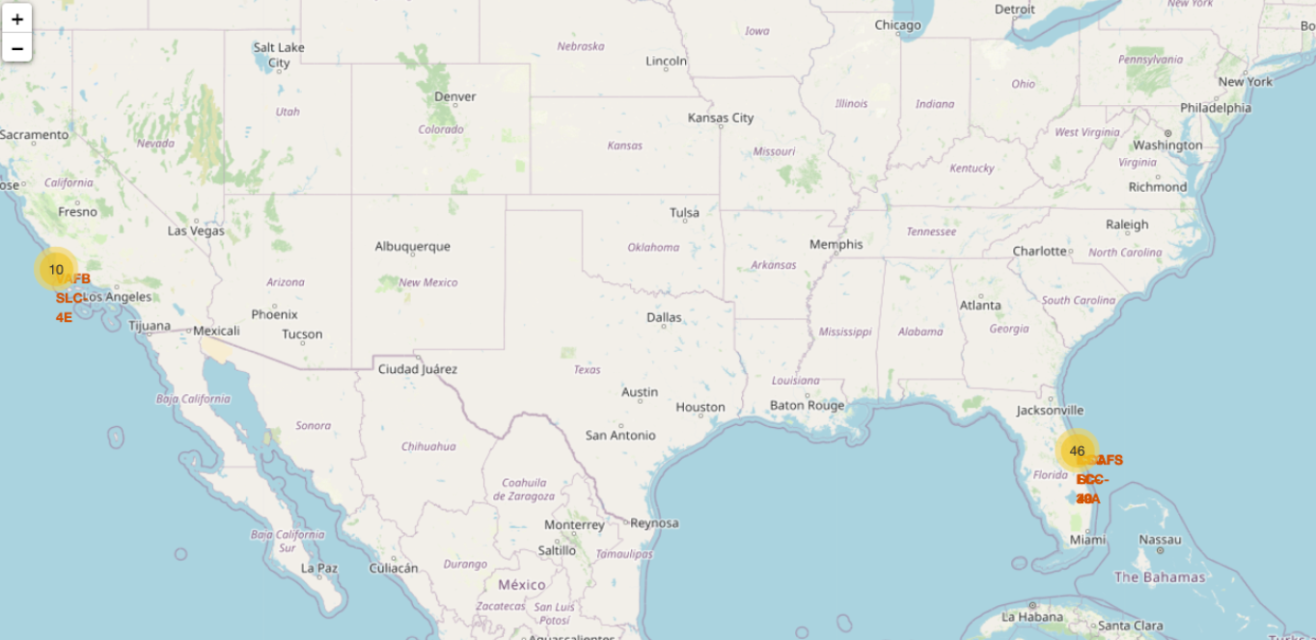
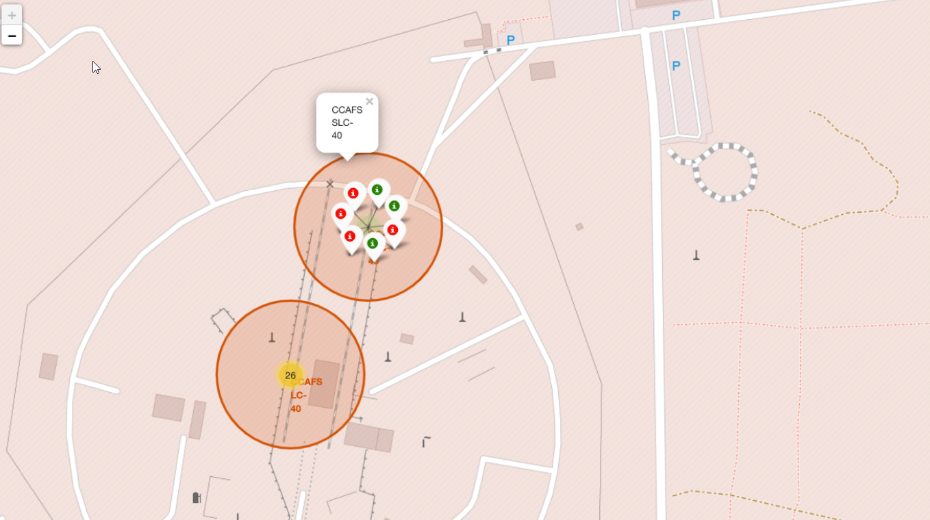



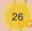
Depicting Launch Outcomes on the Folium Map
Green markers indicate successful launches.
Red markers indicate unsuccessful launches.
Yellow markers indicate overlapping red and green markers, with the count displayed at the center.

Slide 40
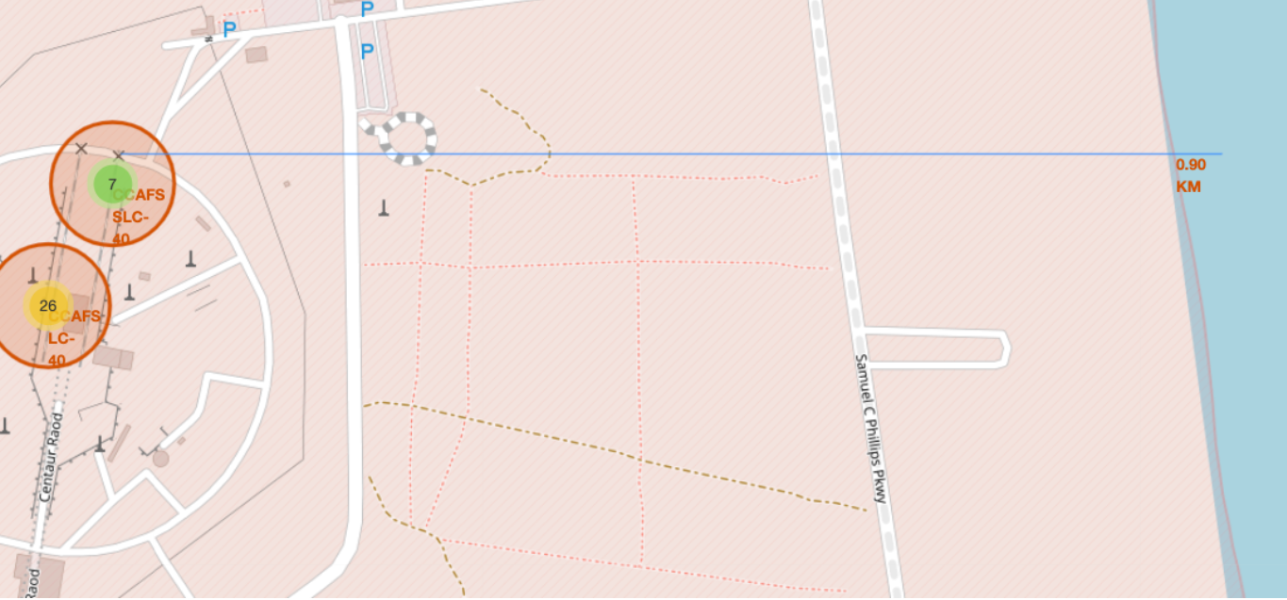
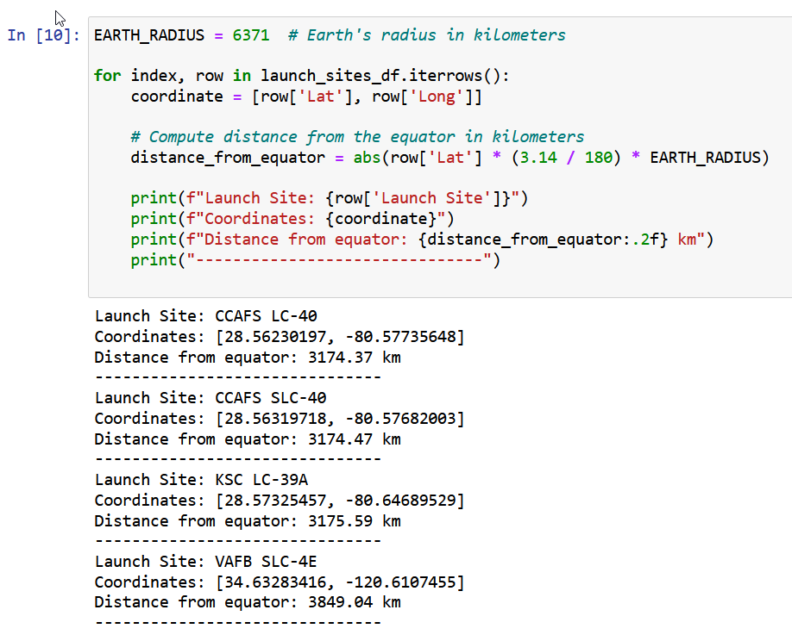
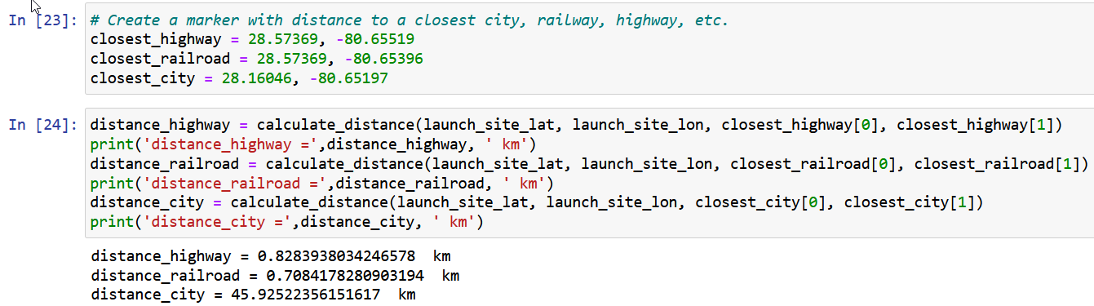
Launch Site Proximity Analysis on Folium Map
Figure: distance CCAFS SLC-40 to coastline
Figure: Measuring Distances to Equator
Figure: Marking Infrastructure and Measuring Distances with Folium

Slide 41
Conclusions from Launch Site Proximity Analysis
All SpaceX Launch Site Locations*
Close to the sea – approximately 1 km away.
Within 1 km of transportation infrastructure.
Away from large cities – at least 45 km away.
Globally, quite close to the equator – between 3000 km and 4000 km away.
Positioned as close to the equator as feasible within the USA, considering the constraints mentioned above.
*All measurements were conducted at the CCAFS SLC-40 launch site. The conclusions were visually compared to other identified launch sites and were found to be consistent.

Slide 42
Conclusions from Launch Site Proximity Analysis
Rationale for SpaceX Launch Site Locations*
Proximity to railways enables efficient transportation of cargo and staff.
Proximity to highways enables efficient transportation of cargo and staff.
Proximity to coastlines:
enables sea transportation, crucial for landing platforms (!).
reduces the risk of harm to civilians, as the sea is not inhabited.
Safe distance to populated areas minimizes risks to civilians in case of flight events.
Positioned relatively close to the equator to use some rotational energy from planet Earth.
Located within the USA, mainly for safety, security and regulatory reasons.
*All measurements were conducted at the CCAFS SLC-40 launch site. The conclusions were visually compared to other identified launch sites and were found to be consistent.

Slide 43

Section 4

Slide 44
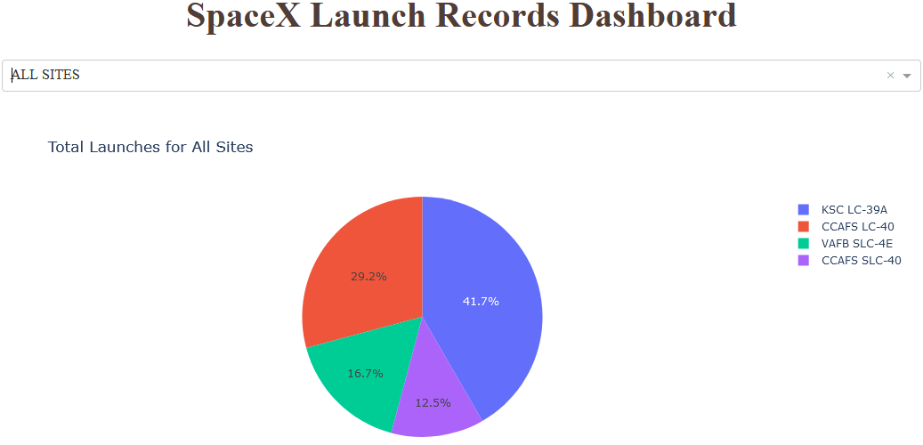
Success Count for all Sites
Launch Site KSC LC-39A has the highest launch success ratio with 76,9% (see also next slide)
It is followed by CCAFS LC-40 with 73,1%
where low success ratios are associated with CCAFS SLC-40 42,9%
VAFB SLC-4E 40%

Slide 45
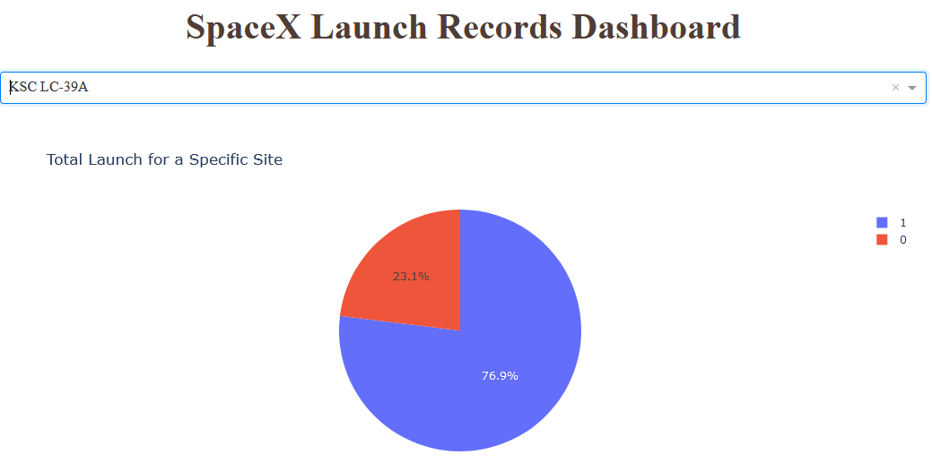
Launch Site with Highest Launch Success Ratio
Launch Site KSC LC-39A has the highest launch success ratio with 76,9%
The highest launch success ratio is also associated with:
Booster type FT and big pay load.

Slide 46
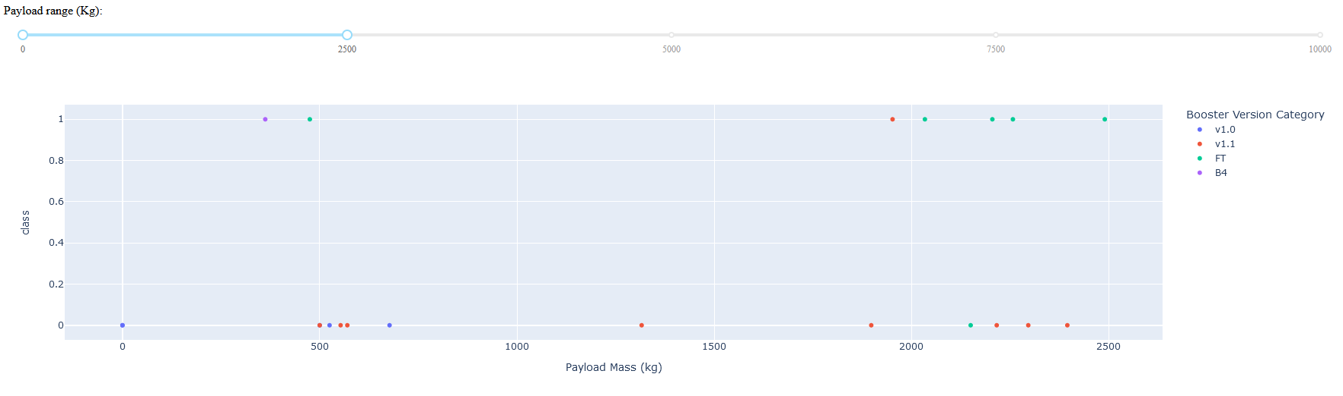
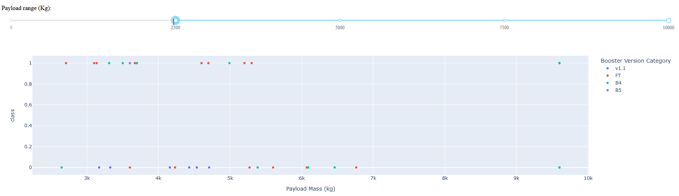
Payload vs. Launch Outcome for All Sites
Figure depicting payload vs. Launch for low payloads up to 2500 kg
Figure depicting payload vs. Launch for big payloads between 2500 kg and 10000 kg

Slide 47
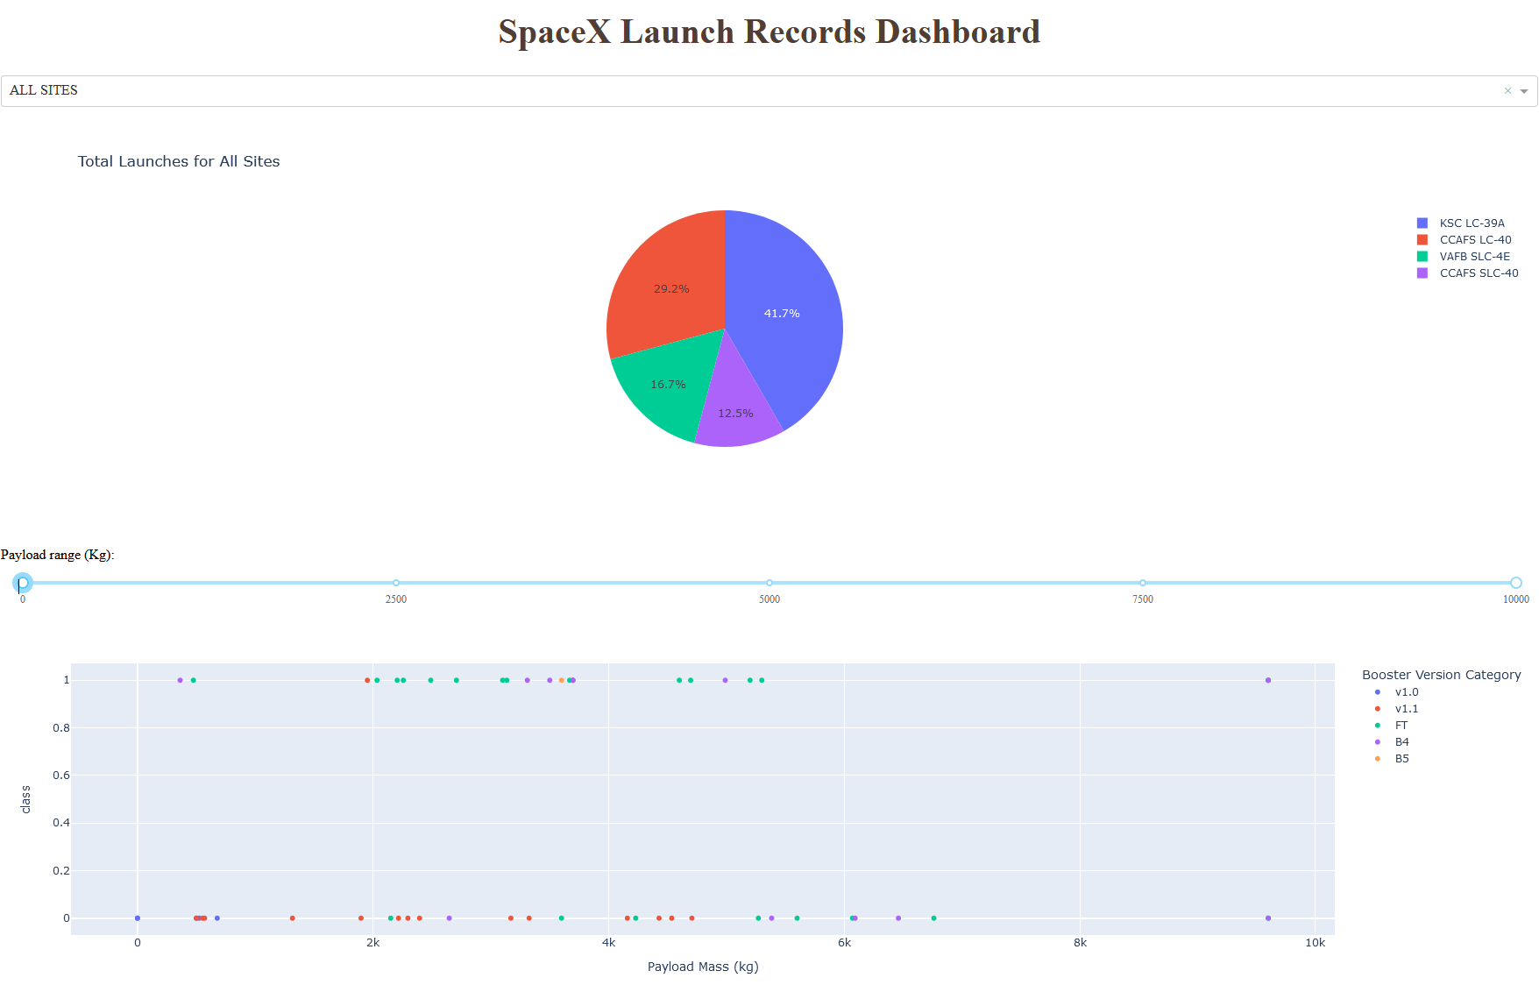
Payload vs. Launch Outcome continued
Baseline figure
Depicting payload vs. Launch Outcome for all Payloads from min to max Payloads

Slide 48

Section 5

Slide 49
Classification Accuracy
Algorithm | Accuracy | Accuracy on Test Data | Tuned Hyperparameters
Logistic Regression | 0.84642857 14285713 | 0.8333333333333334 | {'C': 0.01, 'penalty': 'l2', 'solver': 'lbfgs'}
SVM | 0.8482142857142856 | 0.8333333333333334 | {'C': 1.0, 'gamma': 0.03162277660168379, 'kernel': 'sigmoid'}
Decision Tree I | 0.9053571428571429 | 0.8333333333333334 | {'criterion': 'entropy', 'max_depth': 4, 'max_features': 'sqrt', 'min_samples_leaf': 1, 'min_samples_split': 5, 'splitter': 'random'}
Decision Tree II | 0.875 | 0.8333333333333334 | {'criterion': 'gini', 'max_depth': 4, 'max_features': 'sqrt', 'min_samples_leaf': 1, 'min_samples_split': 5, 'splitter': 'random'}
KNN | 0.8482142857142858 | 0.8333333333333334 | {'algorithm': 'auto', 'n_neighbors': 10, 'p': 1}
The decision tree model outperforms others in classification accuracy, achieving approximately 90%, closely followed by other models at around 85%.
The link to the notebook is https://github.com/sebnotch/presi-and-code-data-science/blob/main/SpaceX_Machine_Learning_Prediction_Part_5.jupyterlite.ipynb

Slide 50
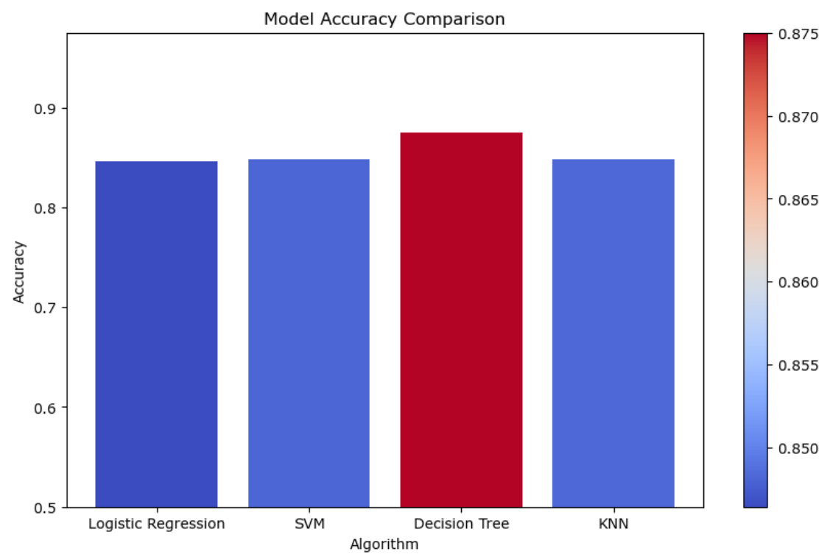
Classification Accuracy continued
The decision tree model outperforms others in classification accuracy, achieving approximately 90%, closely followed by other models at around 85%.
Side note: the accuracy of the decision tree algorithm seems to vary for several runs within jupyter slightly. However, the decision tree model is always better than all the other checked models
This behaviour should be further investigated, compare slide 54 on “Open questions”.
Figure: Algorithm vs Accuracy
The link to the notebook is https://github.com/sebnotch/presi-and-code-data-science/blob/main/SpaceX_Machine_Learning_Prediction_Part_5.jupyterlite.ipynb

Slide 51
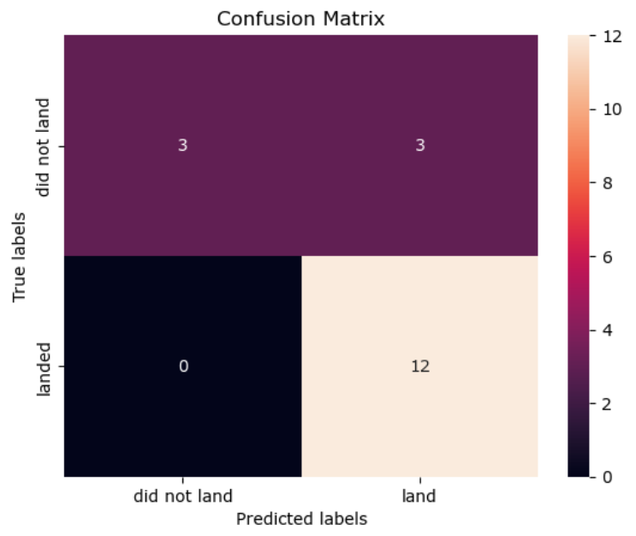
Confusion Matrix
The confusion matrix of the best performing model is identical to the confusion matrices of all other applied models
In other words, all models are predicting
Not landed 3 times correctly (true negatives, upper left square)
Landed 12 times correctly (true positives, lower right square)
Landed 3 time incorrectly (false positive, upper right square) (this indicates the main weakness of the models)
Did not land 0 times incorrectly (false negative, lower left square) (which in fact is correct)
Figure: confusion matrix of all models

Slide 52
Confusion Matrix continued
Accuracy: (TP + TN) / Total =(3+12)/18 = 0.833
Misclassification Rate: (FP + FN) / Total =(3+0)/18 = 0.1667
Precision: TP/ all positive predicted =12 / 15 = 0.8
Prevalence: actual all positive / Total =0 + 12 / 18 = 0.667
Accuracy + Misclassification Rate = 1
TN (true negative)
FP (false positive)
FP (false negative)
TP (true positive)
Figure: confusion matrix of all tested models

Slide 53
Conclusions
Attributes contributing to higher launch success rates were identified and include:
Orbits such as ES-L1, GEO, HEO, SSO, VLEO
Launches conducted in the later project phases
Larger payloads
The presentation suggests possible explanations for these factors.
A decision tree classifier was identified as the optimum machine learning model with an accuracy exceeding 90%.
The ML model helps to scrutinize and to quantify the findings mentioned above.
Based on the above findings, further improvements to the SpaceX program are suggested, such as incorporating additional design parameters, including launch height, detailed in the next slides.

Slide 54
Open Questions - Areas for deeper data analysis should include
Model / Data related items
– as models demonstrated similar accuracy –
Consider investigating alternative models which may score much better (including sensitivity against several decision tree runs)
Explore what additional data could have the potential to improve the model performance.
Consider segmenting the dataset into
distinct categories,
such as low and high payloads and
apply and optimize separate models for each.
The latter strategy assumes that each category has unique behavior which can be captured with a specific model. It this turns out to be true, that would be a way for further improved accuracy.

Slide 55
Open Questions - Areas … continued
Pay load related items
The data suggests a higher payload mass correlates with higher success rates. The cause behind this correlation need clarification.
Comprehending why larger payloads often result in successful missions could provide insights for enhancing future launches.
Examining the payload mass and cost relationship to determine if the pay load cost affects the mission success. ➔ Payload cost analysis could show that lower costs are associated with test flights (possibly planned aborts), while higher costs imply missions of high importance (possibly no planned aborts).

Slide 56
Open Questions - Areas … continued
Flight length related items
The length of the flight before an abort may reflect the degree of command and control over the Falcon 9. A short flight suggests less control, while a longer flight implies more effective command and control.
The type of early flight termination — whether intentional for safety or due to technical problems — also indicates the level of command and control.

Slide 57
Outlook and Proposal
Elevated Launch Sites for Energy Saving at Launch
Core Concept: Utilizing high-altitude regions like mountains or lakes may offer advantages for launches by reducing the distance to orbit (which reduces gravitation and friction in the atmosphere).
Strategic Approach: Deploy Folium for an advanced search to pinpoint geographical areas that align with established Criteria (infrastructure availability, Proximity to the coastline and to the equatorial line) plus a new Criterion: high-altitude terrain for launch site.
Pragmatic Exploration: Searching for potential new launch locations at higher altitudes, with initial candidates including regions in India, Hawaii, the Rocky Mountains, Lake Victoria, and Lake Titicaca.
Objective: Document exact positions and elevations to enable further assessments regarding the feasibility and quantification of possible energy savings at each proposed site.

Slide 58


Vision of energy saving with
The prospect from the future reads:
x
|
Figure: high altitude launch, reducing start mass & saving energy
SpaceX, initially represented by "_X", is now taking on a new identity as "|^{X}". This represents a new era of innovation and commitment to sustainability, beneficial for the company and the planet – a true "Musk-Win Situation".
Technology already exists to move materials from sea level to higher ground for launches. This development can cut down the initial fuel weight or allow for more payload. In short, it achieves a more effective use of fuel per payload, steering SpaceX towards an even greener space travel.

Slide 59

Appendix
All requested details are provided in this presentation (in some cases on slides “… continued”) or through links to GitHub.
For additional background knowledge, it is recommended to consult the 'Falcon User's Guide' (falcon-users-guide-2021-09.pdf , see snapshot on the right).
Figure: snapshot of 1st page from falcon-users-guide-2021-09.pdf

Slide 60
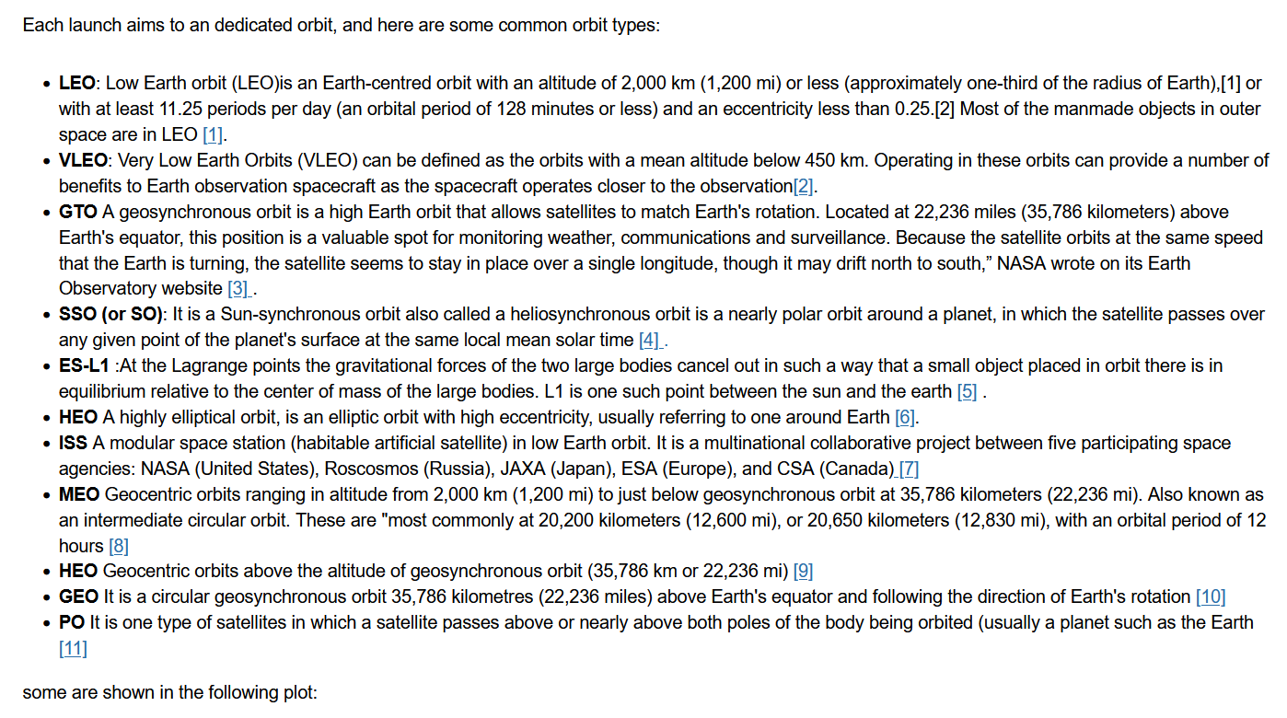
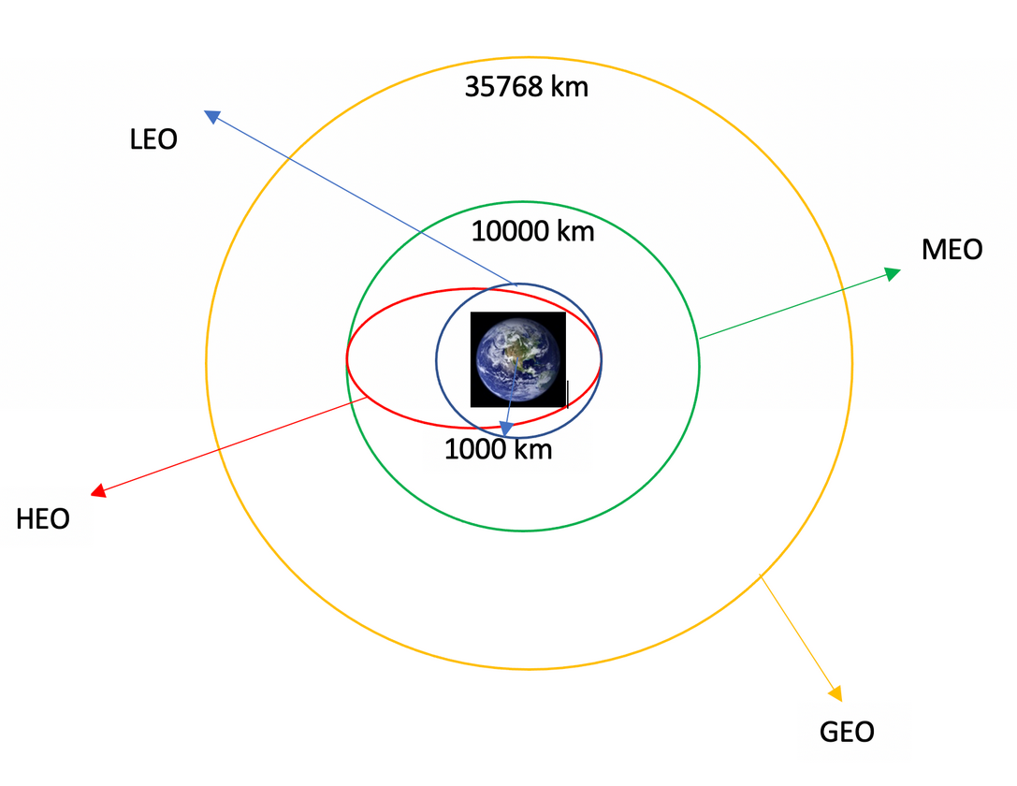
Appendix
Nomenclature (from jupyter notebooks as per GitHub storage)

Slide 61

Thanks to IBM and the team behind

